Slide 1
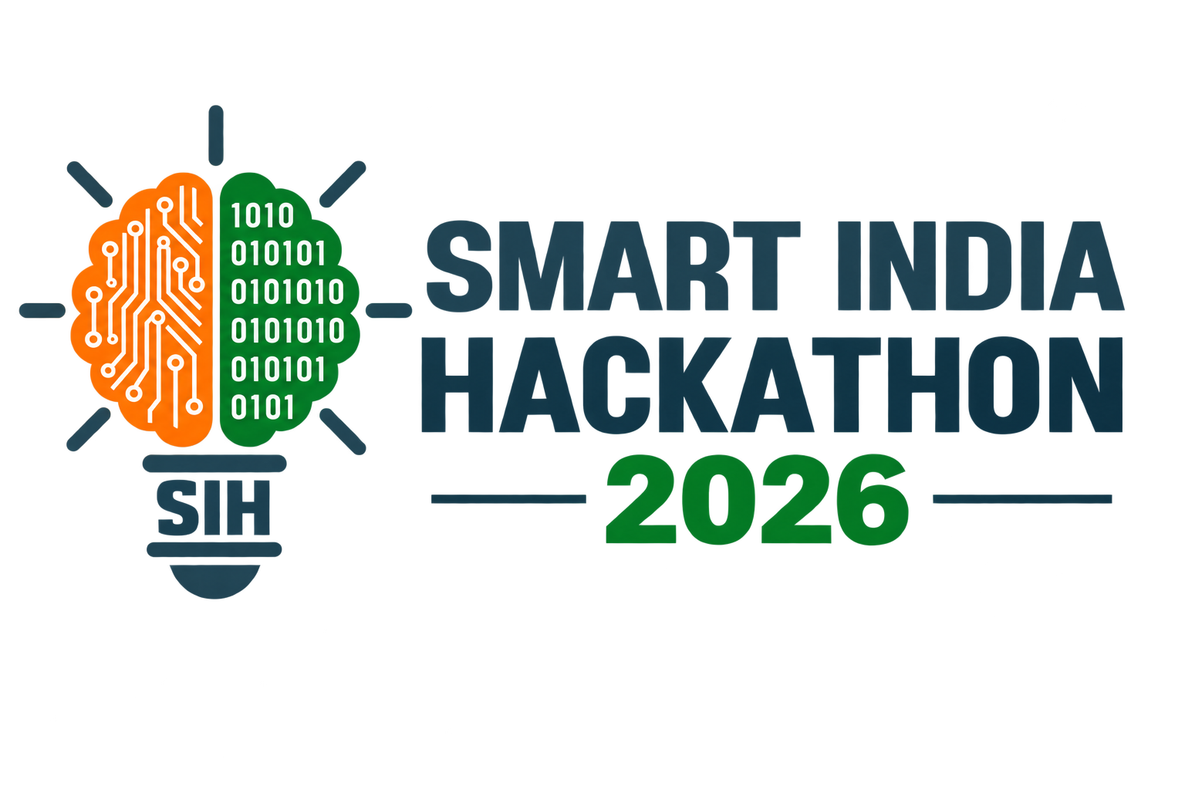

SMART INDIA HACKATHON 2026
Problem Statement ID: 25076
Theme: Agriculture, FoodTech & Rural Development
Problem Statement Title : AI-Based Farmer Query Support and Advisory System PS Category: Software Team Name: Vivasayi ai
Ai-powered multilingual farmer assistance for crop health, farming decisions, irrigation, fertilizers, weather and market information.

Slide 2

PROPOSED SOLUTION
Vivasayi AI is a smart web application that provides farmers with AI-based agricultural support in one platform.
Addressing the Problem
Detects crop diseases from images.
Recommends suitable crops and fertilizers.
Provides weather and irrigation advice.
Provides market price information.
Supports Tamil and English voice queries.
Innovation & Uniqueness
All-in-one AI farming assistant
Personalized recommendations based on farmer and crop data.
Voice-based support for easy rural access.
Combines AI + weather + soil + crop + market information to provide actionable advice.

Slide 3
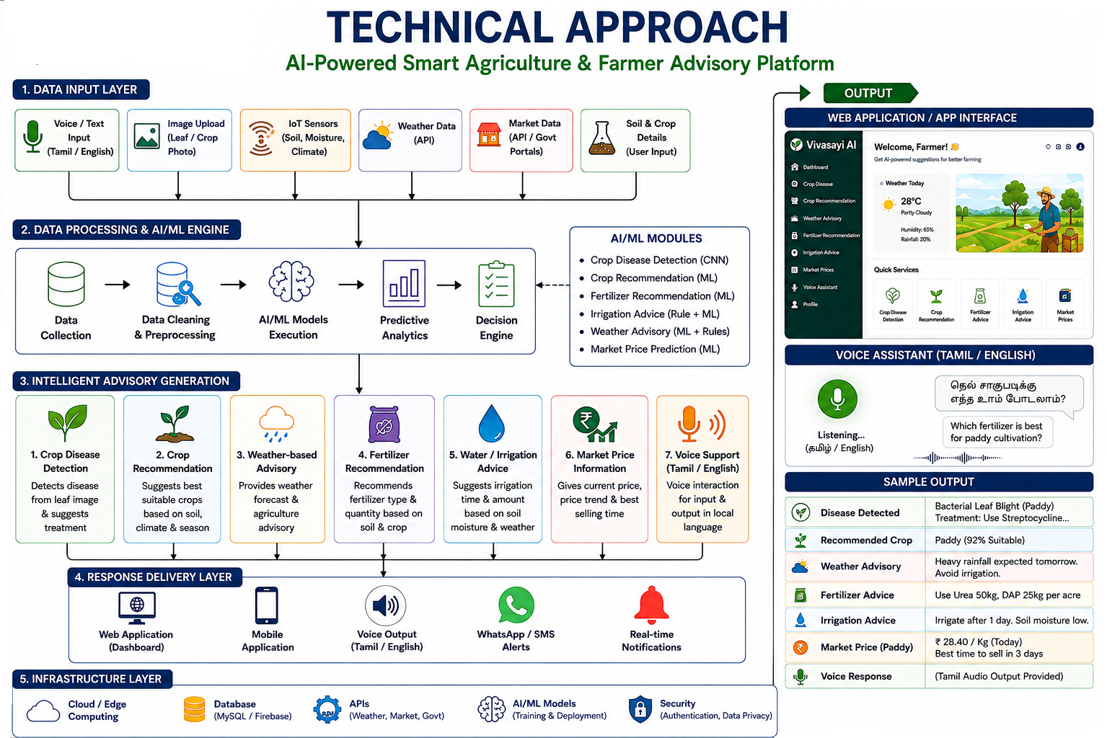

TECHNICAL APPROACH
Hack
Masters
AI/ML: Python (scikit-learn, TensorFlow/PyTorch).
• Database: MySQL / MongoDB.
• Frontend: React / Angular.
• Backend: Flask / Node.js
• Counseling Chatbot: NLP (Dialogflow / OpenAI API).
• Visualization: Power BI / Tableau.

Slide 4
FEASIBILITY AND VIABILITY
Technically Feasible – Uses existing AI/ML, web and API technologies.
Cost Effective – Can be developed using open-source tools and datasets.
Easy to Use – Simple web interface with Tamil/English voice support.
Scalable – Can support more crops, farmers and regions.
Practical – Provides real-time and personalized farming advice.
Sustainable – Helps reduce crop loss, water wastage and unnecessary fertilizer use.

Slide 5
IMPACT AND BENEFITS
Increased Crop Productivity – Provides timely and personalized recommendations to support better farming decisions and improve yield.
Reduced Crop Losses – Early crop disease detection helps farmers identify problems and take preventive action.
Efficient Water Usage – Smart irrigation advice helps reduce unnecessary water consumption and supports sustainable farming.
Better Fertilizer Management – Provides crop- and soil-based fertilizer guidance, helping avoid excessive or inappropriate fertilizer use.
Improved Farmer Decision-Making – Combines crop, soil, weather, and market information to provide actionable recommendations.
Easy Access to Agricultural Support – Farmers can access multiple services through a single web application instead of using separate platforms.
Regional Language Accessibility – Tamil and English voice support makes AI-based agricultural assistance easier for rural farmers to use.
Economic Benefits – Market price information can help farmers make better decisions about when and where to sell their produce.

Slide 6
RESEARCH AND REFERENCES
ICAR (Indian Council of Agricultural Research) – Agricultural research, crop production, crop protection, and farmer advisory resources.
India Meteorological Department (IMD) – Weather and rainfall data used for weather-based agricultural advisories.
Kaggle Agricultural Datasets – Crop recommendation, soil parameters, crop disease, and agricultural datasets for AI/ML model development.
Plant Village Dataset – Open dataset containing crop leaf images used for plant disease detection and classification.
Government of India – AgriStack / Digital Agriculture – References for digital agriculture and technology-enabled farmer services.
eNAM (National Agriculture Market) – Market and agricultural commodity price information.

